Slide 1

REVIEW PART II - CSS
Ranken Technical College

Slide 2
Objectives
Review The 3 CSS Types
Review The CSS Box Model
Explain What CSS Flexbox Is
Explain What CSS Grid Layout Is
Review The Main CSS Selectors
Review The CSS Relational Selectors

Slide 3
Objectives
Review The Use Of CSS3 and Colors
Review CSS3 Gradients
Review CSS3 Transforms
Review CSS3 Transitions
Review CSS3 Animations

Slide 4
Inline CSS
Inline CSS normally styles an individual element
Example (in body section):
<h1 style="color=blue;">Blue h1</h1>
NOTE: This is considered poor style and should be avoided at all times

Slide 5
Internal CSS
Internal CSS normally styles on an individual HTML Page
Example (in head section):
<style>
h1 {
color: "blue";
}
</style>

Slide 6
External CSS
External CSS normally styles an entire HTML Website
Example (in file style.css, folder ccs ):
h1 {
color: "blue";
}
<link rel="stylesheet" href="css/style.css">

Slide 7
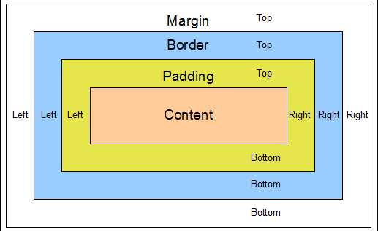
CSS Box Model

Slide 8
CSS Box Model
Content - The content of the box, where text and images appear
Padding - Clears an area around the content. The padding is transparent
Border - A border that goes around the padding and content
Margin - Clears an area outside the border. The margin is transparent

Slide 9
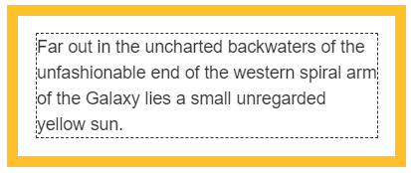
CSS Box Model
Padding - The padding CSS property sets the padding area on all four sides of an element. It is a shorthand for padding-top, padding-right, padding-bottom, and padding-left
Source
https://developer.mozilla.org/en-US/docs/Web/CSS/padding

Slide 10
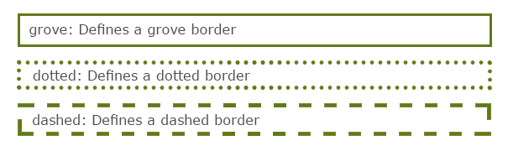
CSS Box Model
Border - The border shorthand CSS property sets an element's border. It sets the values of border-width, border-style, and border-color
Source
https://developer.mozilla.org/en-US/docs/Web/CSS/border

Slide 11
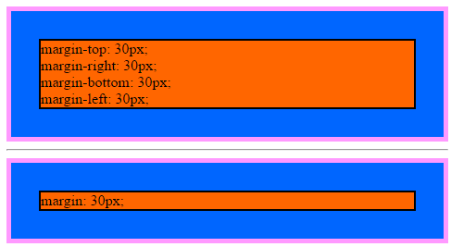
CSS Box Model
Margin - The margin CSS property sets the margin area on all four sides of an element. It is a shorthand for margin-top, margin-right, margin-bottom, and margin-left
Source
https://developer.mozilla.org/en-US/docs/Web/CSS/margin

Slide 12
CSS Flexbox
The Flexible Box Module, a.k.a. flexbox, was designed as a one-dimensional layout model, and as a method that could offer space distribution between items in an interface and powerful alignment capabilities
See https://flexboxfroggy.com/ to learn how to use flexbox
Source
https://developer.mozilla.org/en-US/docs/Web/CSS/CSS_Flexible_Box_Layout/Basic_Concepts_of_Flexbox

Slide 13
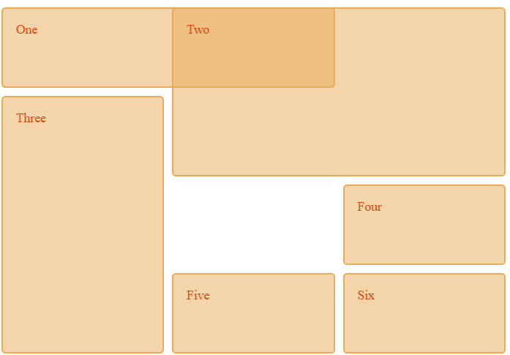
CSS Grid Layout
CSS Grid Layout excels at dividing a page into major regions or defining the relationship in terms of size, position, and layer, between parts of a control built from HTML primitives
Source
https://developer.mozilla.org/en-US/docs/Web/CSS/CSS_Grid_Layout

Slide 14
CSS Selectors
See the following URL for a complete list of all CSS Selectors:
https://developer.mozilla.org/en-US/docs/CSS/CSS_Reference

Slide 15
CSS Class Selector
The class attribute is used to point to a class name in a stylesheet. It can also be used by a JavaScript to access and manipulate elements with that name
Example:
.red {color: red;} (in CSS):
<p class="red">Red paragraph1</p>
<p class="red">Red paragraph2</p>

Slide 16
CSS ID Selector
The id attribute is used to point to an element in a stylesheet. It can also be used by a JavaScript to access and manipulate an element with that name
Example:
#red {color: red;} (in CSS):
<p id="red">Red paragraph1</p>

Slide 17
CSS Selector Categories
Simple Selectors select based on element name, id, or class name
Example:
p {
text-align: center;
color: red;
}
Source
https://www.w3schools.com/CSS/css_selectors.asp

Slide 18
CSS Selector Categories
A combinator selects based upon the relationship between the selectors
Types:
descendant selector (space)
child selector (>)
adjacent sibling selector (+)
general sibling selector (~)
Source
https://www.w3schools.com/CSS/css_combinators.asp

Slide 19
CSS Selector Categories
A pseudo-class selects based on a special state of an element
Types (must be listed in this order to work):
link
visited
hover
active
Source
https://www.w3schools.com/css/css_pseudo_classes.asp

Slide 20
CSS Selector Categories
A CSS pseudo-element is used to style specified parts of an element
Types:
::after Inserts after element
::before Inserts before element
::first-letter Selects first letter
::first-line Selects first line
::selection Selects portion of an element
Source
https://www.w3schools.com/CSS/css_pseudo_elements.asp

Slide 21
CSS Selector Categories
A CSS attribute selector selects elements with a specified attribute
Types:
[attribute]
[attribute=value]
[attribute~=value]
[attribute|=value]
Source
https://www.w3schools.com/CSS/css_attribute_selectors.asp

Slide 22
CSS Selector Categories
A CSS attribute selector selects elements with a specified attribute
Types:
[attribute^=value]
[attribute$=value]
[attribute*=value]
Source
https://www.w3schools.com/CSS/css_attribute_selectors.asp

Slide 23
CSS Colors
CSS3 supports the "old" hexadecimal format for colors, and the rgb() (red, green, blue) format, and the built-in colors
In addition, CSS supports the following color options:
RGBA
HSL
HSLA

Slide 24
CSS Colors
HSL stands for hue, saturation, and lightness. hsl() accepts three values:
hue in degrees from 0 – 359
saturation, as a % where 100% is full hue and 0% causes a shade of gray
percentage for lightness, where 100% is white, 0% is black, and 50% is the norm
Source
https://www.w3schools.com/CSS/css_attribute_selectors.asp

Slide 25
CSS Box-Shadow
The CSS3 box-shadow property takes a comma-separated list of shadows as its value. Each shadow includes a color and:
The horizontal offset
The vertical offset
The blur distance of the shadow
The spread distance of the shadow
Source
https://www.w3schools.com/CSSref/css3_pr_box-shadow.asp

Slide 26
CSS Gradients
CSS Radial Gradients are circular or elliptical gradients. The colors blend out from a starting point in all directions
CSS Linear Gradients are those where colors transition across a straight line, from top to bottom, left to right, or along any arbitrary axis
CSS Repeating Gradients provides both a repeating-linear-gradient and a repeating-radial-gradient gradient
Source
https://developer.mozilla.org/en-US/docs/CSS/Using_CSS_gradients

Slide 27
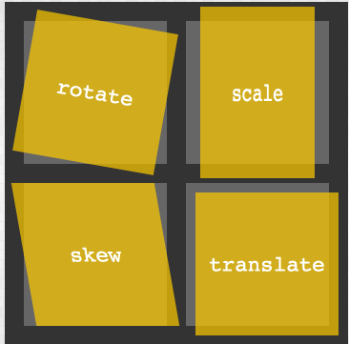
CSS Transforms
The CSS transform property lets the user translate, rotate, scale, or skew an page element. Translation functions let the user move elements left, right, up, or down
Source
https://developer.mozilla.org/en-US/docs/CSS/Tutorials/Using_CSS_transforms

Slide 28

CSS Transitions
Transitions allow the values of CSS properties to change over time, in essence providing simple animations
Source
https://developer.mozilla.org/en-US/docs/CSS/Tutorials/Using_CSS_transforms

Slide 29

CSS Animations
CSS animations involve the use of keyframes, i.e. a snapshot that defines a start/end point of a smooth transition
Source
https://developer.mozilla.org/en-US/docs/Web/CSS/CSS_Animations/Using_CSS_animations

Slide 30
What We Covered
The 3 CSS Types
The CSS Box Model
CSS Flexbox
CSS Grid Layout
The Main CSS Selectors
The CSS Relational Selector

Slide 31
What We Covered
The Use Of CSS3 and Colors
CSS3 Box-Shadow
CSS3 Gradients
CSS3 Transforms
CSS3 Transitions
CSS3 Animations

Slide 32
Some Useful URLs
https://developer.mozilla.org/en-US/docs/Web/CSS/Reference
https://developer.mozilla.org/en-US/docs/Learn/CSS/First_steps
https://www.w3schools.com/Css/

